Slide 1
EXPERIMENTATION LAB
Outi Kuittinen
Demos

Slide 2

2 hour
quick & dirty intro class to experimentation
1,5 hour advanced class
in the afternoon to continue with experiment design

Slide 3
MÅL FÖR DAGENS WORKSHOP
Förstå varför experiment kan vara användbart för offentlig sektor – både som verktyg och förhållningssätt.
Få kunskap om hur strategiska mål kan översättas till hypoteser och experimentella satsningar.
Få idéer till att initiera ett experiment!
Allt detta på två timmar!

Slide 4
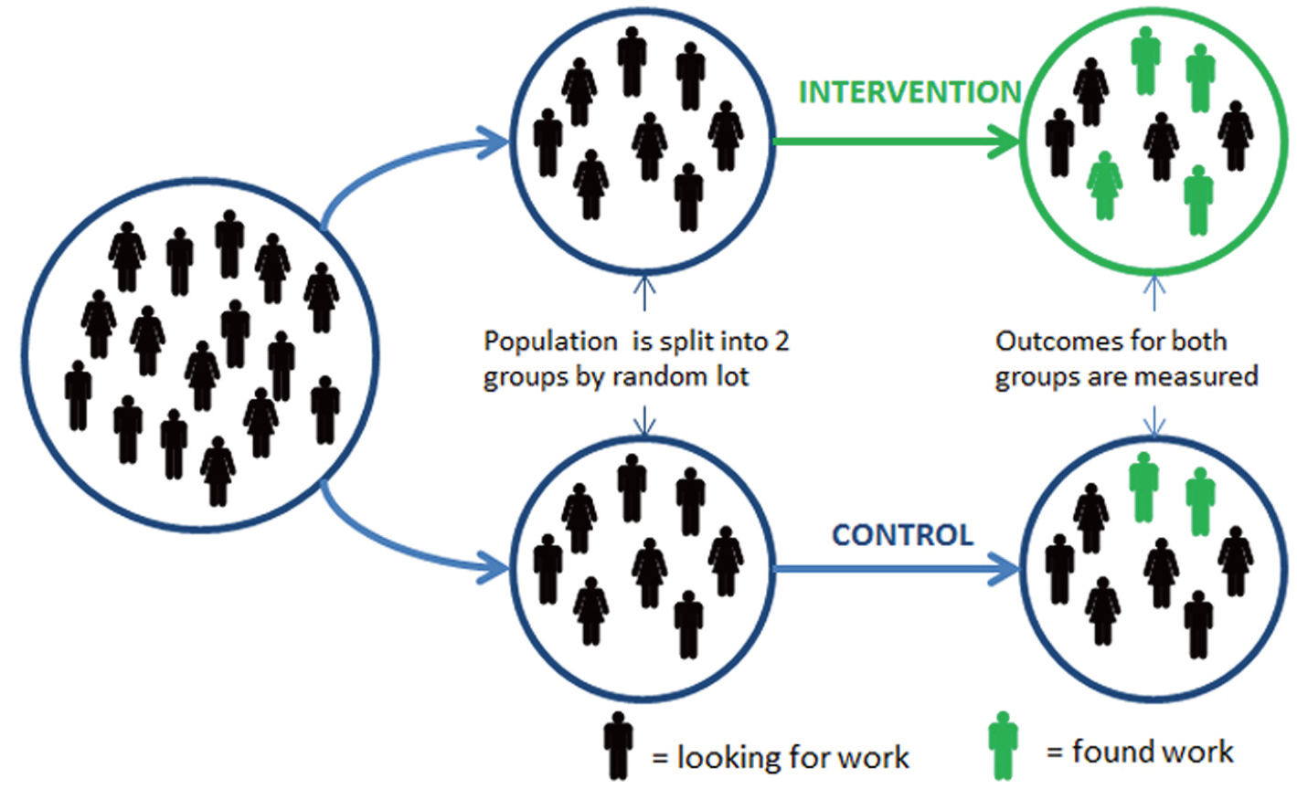
What is public sector experimentation?
Tied to policy aims
There is uncertainty of the outcome
Temporary activity
Possibility to evaluate successes and failures
Someone who has mandate is waiting for the results to learn how the strategic objective can be reached
Notes:
Complex and new matters are very difficult or even impossible to plan in advance
It is the end-users - citizen - who decide whether a service or policy is good or not
Experimentation helps to show others - partners, people and related stakeholders - how intended policy or service would work
Failing before scaling: experimentation enables one to see if an initiative works before it is adopted in a large scale
If goals of an experiment are defined together, the policy is more likely to be accepted by the public (if it works)

Slide 5
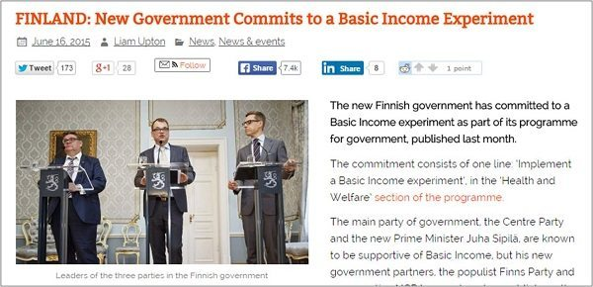
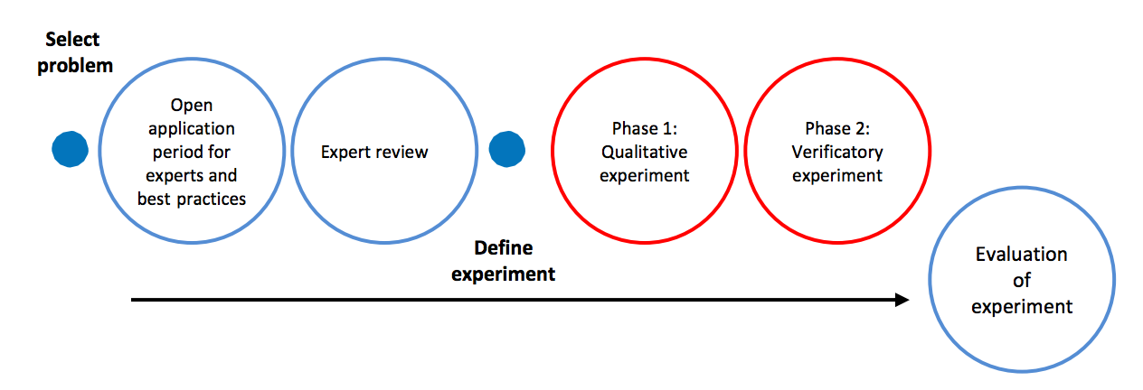
The Experiment process for the government
The idea of the model is that it brings stakeholders around the problem and engages citizens and end-users in the experimentation process.
Notes:
So we ended up proposing an operational model that would help ministries to run their experiments. Idea of the model is that it brings stakeholders around the problem and engages citizen and end-users in the experimentation process.
For example in case of smart mobility and robot buses, which by the way we are also involved with, experimentation is about engaging not only mobility related actors but also for example municipalities, retail companies, insurance companies and end-users to elaborate how future mobility should be, and what should be experimented…
There you see, for example robot buses, they are already in traffic, being experimented among the other traffic. Our team is also part of that experimentation.

Slide 6
Linking Experimentation to Strategy or Policy
Policy
or strategic
objectives
Experiment(s)
Learning, Evaluation
Feedback to policy or strategic steering
Notes:
(((In Finland, when the current government program was written, the government managed to build a link between experiments and strategic steering. Experiments went to the core of government. In a word, there is an experimental program in the government program. There is a set of experiments and an end evaluation of the program and experiments. This again feeds back to next government program. Idea is that 1) experiments transform into results and then into policy; but 2) government learns to know how and when experimentation works as part of steering, and becomes a learning state))

Slide 7

Case: What if in finding a job, we helped planning the future instead of controlling the past?
Objective: More unemployed to find jobs (Government’s goal: increasing employment rate to 72 % from 68 %)
What if (hypothesis): Now job seekers report their efforts to Job Centres. What if concentrating on future efforts brought better results?
Problem: Changing national level customer service is risky.
Experiment 1. Experimenting in limited scale: one Job Centre started making ‘future plans’ instead of monitoring.
Results: Future plans increase employment figures by 5%.
Experiment 2. Experiment replicated in 12 Job Centres. Effect is smaller, but still significant: 2% increase in employment.
Results: 25 000 customer service workers trained to follow the new plan.

Slide 8
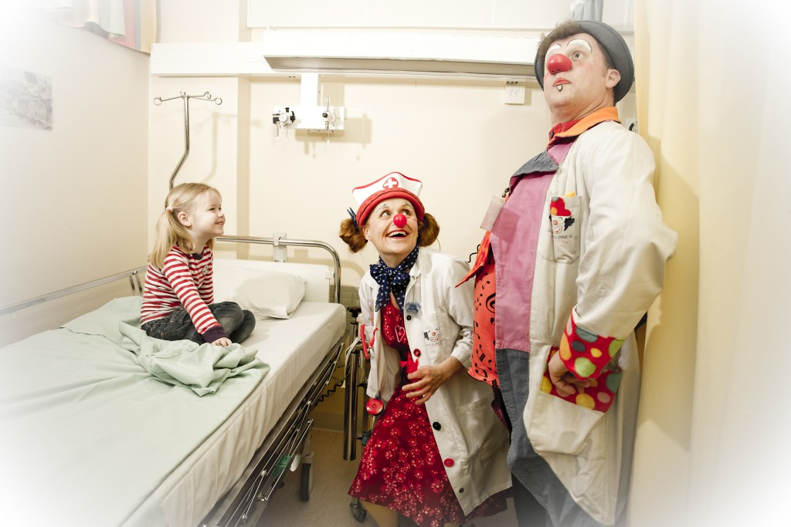
Case: What if arts and culture were systematically integrated into the social and health system?
Objective of the Ministry: To improve access to art & culture and root art and culture based well-being services as part of the structures of social and health care.
Science shows that some arts forms do improve health. Ministry of Education and Culture funds arts which is ad hoc utilized in social and health care environments.
What we want to learn: How to integrate art to healthcare systematically? What are the models? What are the benefits really?
Notes:
Starting point:
Science shows that some arts forms improve health
Ministry of Education and Culture is funding arts which is ad hoc utilized in social and health environments
broaden the use of so called “1 % principle” (1 % of the budget of e.g. public building projects is to be used in public art)
Co-Design phase determined experiments: 1) Must show health benefits; 2) Must show process benefits; 3) Must find out how integration can be done in terms of regulation
Qualitative experiment phase: 7 fast experiments are conducted. Target groups: children; elderly people; those in danger of burnout; youngsters with mental problems; clients with alcohol and substance problems; parents of young childern.
Quantitative experiment phase (will start in January):
Hospital clowns aim for improving children’s well-being and process-efficiency of hospitals.
Order-to-your-home-artists visit families that are at risk of being become marginalized. They aim for improving families’ well-being and also attracting them to join group activites, and eventually getting to interact with other citizen.

Slide 9
Case: What if arts and culture were systematically integrated into the social and health system?
Co-design phase with various stakeholders determined that experiments should:
1) Show health benefits
2) Show process benefits
3) Inform how integration can be done in terms of regulation
Phase 1: 7 quick experiments
Target groups: children, elderly people, those in danger of burnout; youngsters with mental problems, clients with alcohol and substance problems, parents of young children
Phase 2: 2 into verificatory experiment phase
Care Clowns for kids improving children’s well-being and process-efficiency of hospitals
“Home-delivery” artists visit families at risk of being become marginalized. Aim to improving families’ well-being and also attract them to join group activites, and eventually to interact with other citizen.
Policy link: Informed by the results of these experiments, the Minister will provide recommendations to regions and municipalities on how to use art and culture based services as a regular part of health & social services.
Notes:
Starting point:
Science shows that some arts forms improve health
Ministry of Education and Culture is funding arts which is ad hoc utilized in social and health environments
Co-Design phase determined experiments: 1) Must show health benefits; 2) Must show process benefits; 3) Must find out how integration can be done in terms of regulation
Qualitative experiment phase: 7 fast experiments are conducted. Target groups: children; elderly people; those in danger of burnout; youngsters with mental problems; clients with alcohol and substance problems; parents of young childern.
Quantitative experiment phase (will start in January):
Hospital clowns aim for improving children’s well-being and process-efficiency of hospitals.
Order-to-your-home-artists visit families that are at risk of being become marginalized. They aim for improving families’ well-being and also attracting them to join group activites, and eventually getting to interact with other citizen.

Slide 10
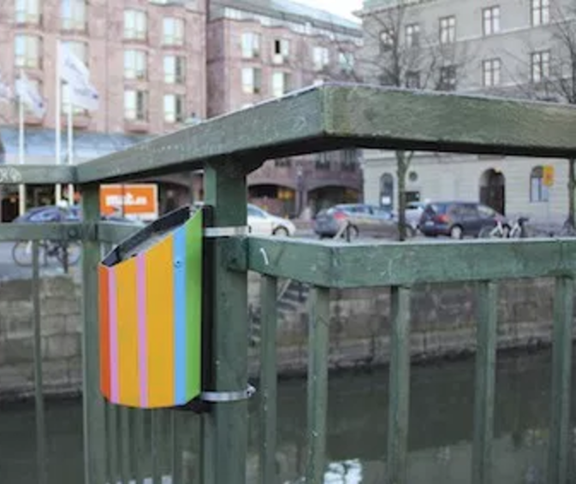
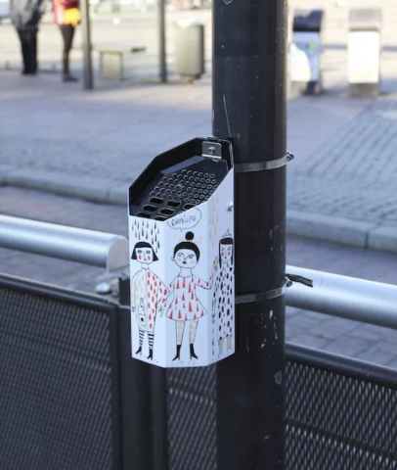
Case: Using behavioural science to decrease littering in Gothenburg
Objective of City of Gothenburg: Littering is a problem in terms of pollution, attractiveness as well as expenditure of cities. > Objective to increase attractiveness and decrease littering and its costs.
People say they want to keep urban environment tidy but admit littering. Knowledge about human psychology can be applied to steer behavior into desired direction, so called “nudging”.
Redefined objective: Reduce cigarette litter
Experiments: Replace normal black ashtrays in some areas with colourful ashtrays and fun communications. In control areas only black ashtrays.
Results: Compared to the control areas, littering reduced significantly in areas with new ashtrays and communications. Also people experienced the environment significantly as more tidy.
Link to policy: Policy-recommendations based on results.
Notes:
Göteborgin kaupunki halusi lisätä keskustan viihtyisyyttä sekä vähentää roskaamisesta koituvia siivoushaittoja. Selvitysten mukaan useimmat ihmiset haluaisivat pitää kaupunkiympäristön siistinä, mutta siitä huolimatta monet myöntävät ainakin silloin tällöin tai säännöllisesti roskaavansa. Nudging Gothenburg -kokeilu- ja arviointihankkeessa (2016) hyödynnettiin käyttäytymistieteellistä lähestymistapaa ja satunnastettuihin kenttäkokeiluihin pohjautuvaa vaikuttavuusanalyysia tavoitteiden saavuttamiseen. Juha Leppänen johti hankkeen kokeiluasetelman suunnittelua sekä vaikuttavuusanalyysien toteutusta. Teoreettisen viitekehyksen ja aiemman näytön mukaan saavutettavuus (accessibility) oli vahvasti roskaamiskäyttäytymistä selittävä tekijä. Hankkeessa päätettiin tarkentaa siihen, millä toimenpiteillä savukkeiden jätteet vähenesivät katukuvasta. Tilastollisesti merkitsevät tulokset osoittivat, että kaupungin laajalti käyttämät mustat tuhkakupit lisäsivät tupakointia sekä roskaamista. Vaikuttavuusanalyysit myös osoittivat, että huomiota herättävien värillisten tuhkakuppien sekä hauskojen ohjeistusten lisääminen katukuvaan saivat ihmiset pitämään kaupunkiympäristön huomattavasti siistimpänä.

Slide 11
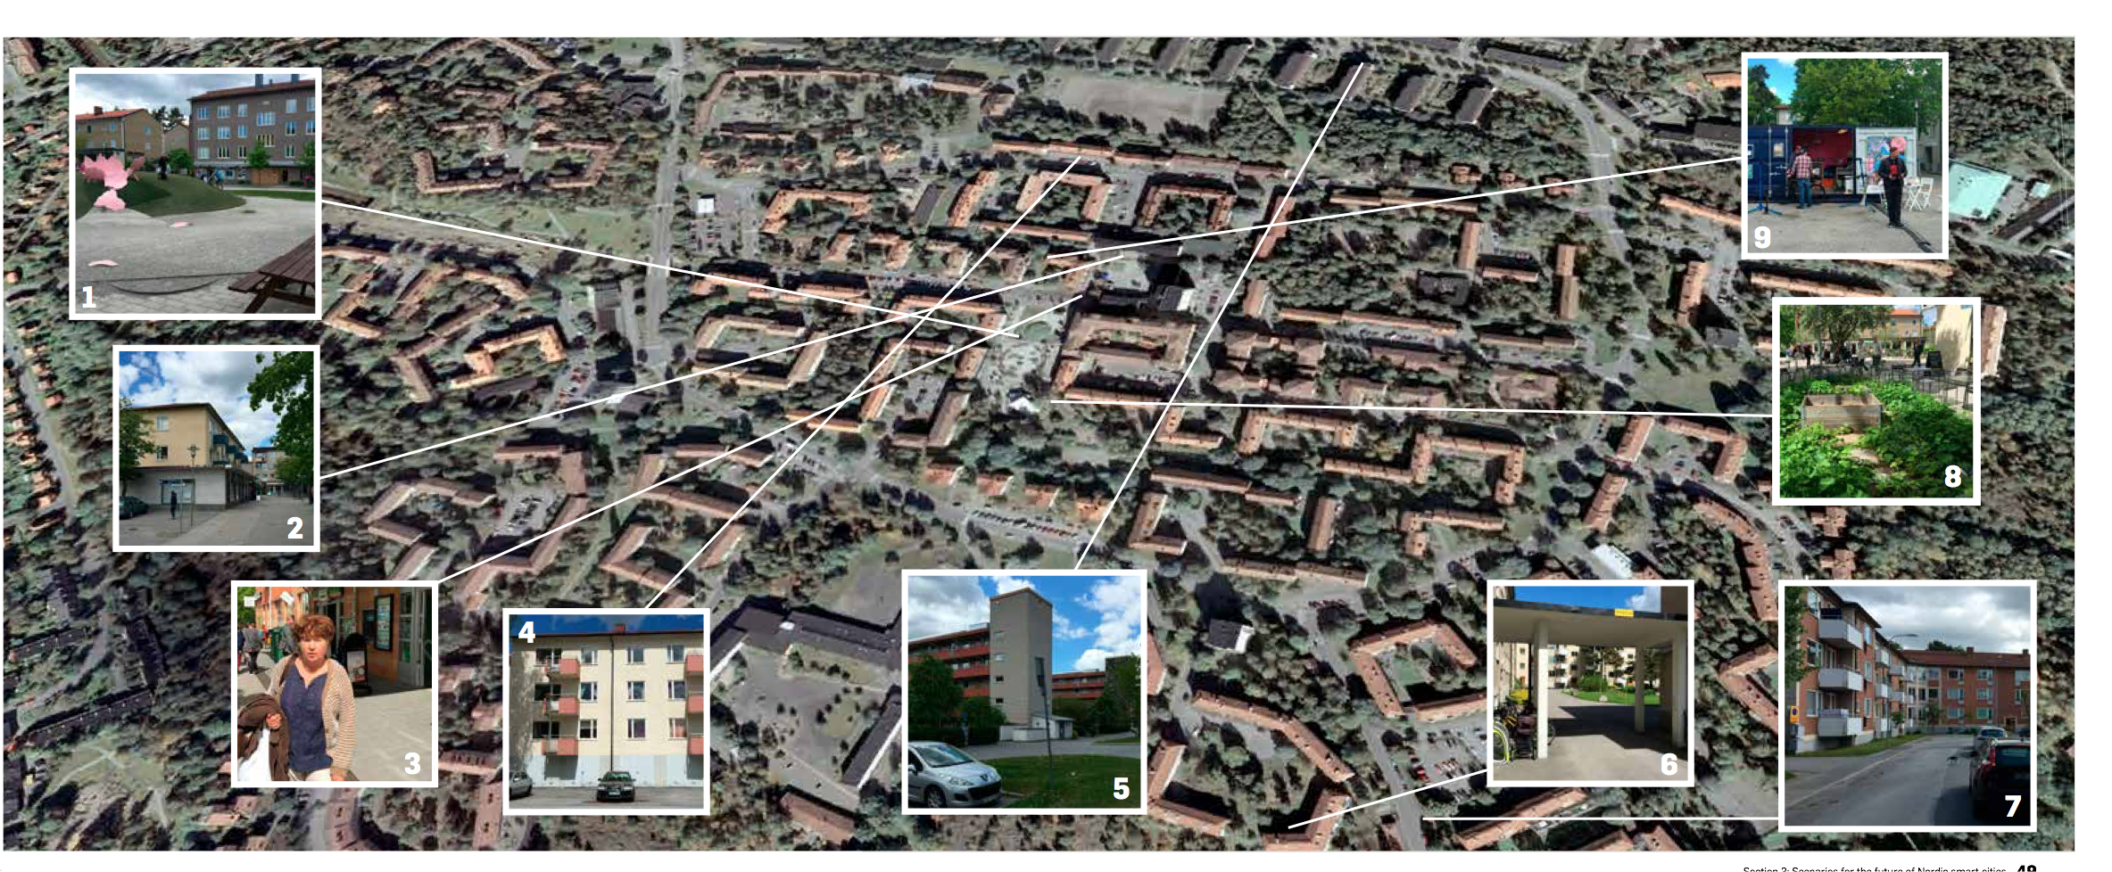
Case: Co-designing new services by using cities as urban testbeds, public sector as a co-creator and enabler for companies & startups to test & develop
LAHTI & STOCKHOLM
Goal:
Contribute to the climate goals of cities by enabling sustainable lifestyles
Make urban areas more attractive by new services
Enable new business
Notes:
THIS IS A CITY LEVEL EXAMPLE
Of course, in the end, the experiments are not done in ministries or not even its agencies.
They are doing around us. In cities, it’s buildings, its houses.
This is why one very important aspect to experimentation is collaboration between different stakeholders right where the action happens
To make it concrete, I show one process that I was running a few years back.
It also illustrates that public sector experimentation does not require anything being written in government program. It needs will to do things differently and will to collaborate.
IN THIS PROJECT, THREE NORDIC MUNICIPALITIES WANTED TO TRY HOW EXPERIMENTATION CAN MAKE THEIR URBAN AREAS MORE SUSTAINABLE AND ATTRACTIVE. WE FACILITATED THIS IN LAHTI, OSLO AND STOCKHOLM.

Slide 12
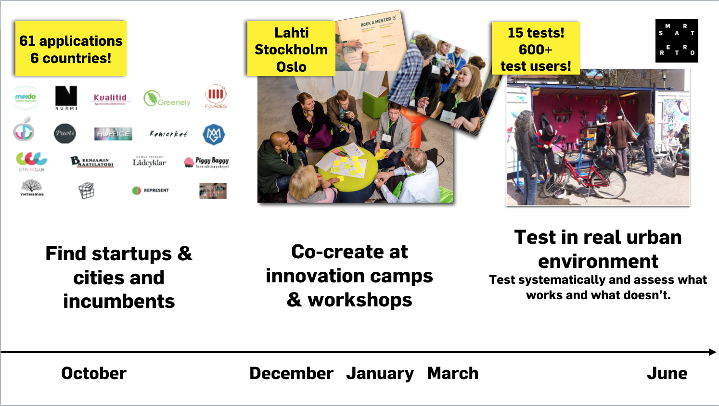
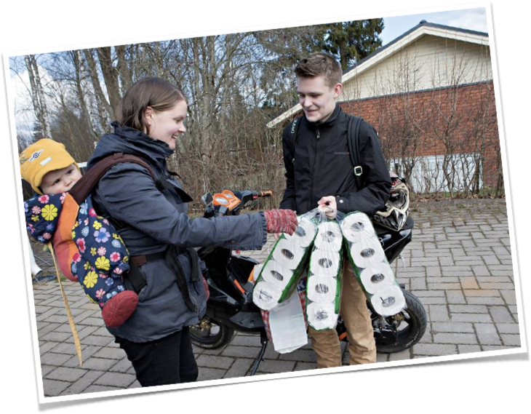
Notes:
HOW THIS HAPPENED?

Slide 13

Learning to see the world with eyes of an experimenter
Transform broader objectives into more narrow experiments
Transform objectives into assumptions & hypotheses
Figure out how to test hypotheses
Learn through experiments

Slide 14
Mål:
I regionen ska det startas minst 13 företag per 1000 invånare år 2020

Slide 15
Mål:
I regionen ska det startas minst 13 företag per 1000 invånare år 2020
Antagande av problem på grund av bakgrundsinformation
Brist på kunskap hindrar individer från att starta eget företag
Bristande service i myndighetskontakter är ett hinder
Många idébärare hittar inte in i stödsystemet

Slide 16
Erbjuda kostnadsfri utbildning i entreprenörskap
Mål:
I regionen ska det startas minst 13 företag per 1000 invånare år 2020
L1
L2
Erbjuda de som startar företag en personlig koordinator för myndighetskontakter
L3
Placera innovationscoacher på populära ställen
L4
L = lösning
Lösningen är avgränsad i omfattning
Lösningen testas en begränsad period
med en experiment
Det är är möjligt att utvärdera om lösningen fungerar eller inte

Slide 17
Mål:
I regionen ska det startas minst 13 företag per 1000 invånare år 2020
L1
L2
I experiment testar du en föreslagen lösning för att se om den fungerar
L3
L4
Innovationscoach på populära ställen

Slide 18
Mål:
I regionen ska det startas minst 13 företag per 1000 invånare år 2020
L1
> Experiment:
Placera innovationscoacher på fem populära caféer i regionen tre dagar i veckan.
Över en period på två månader.
Utvärdera resultatet. (ökning av antal kunder som har gått vidare med sin idé till Nyföretagar-
centrum)
L2
L3
L4
Innovationscoach på populärä ställen

Slide 19
BYGGSTENARNA I ETT EXPERIMENT
Strategier, policies och
de uppsatta målen
Utvärdering
Kunskap
Människor

Slide 20
Byggstenar för ett holistiskt experimenterande
Sätt ambitiösa mål
Utveckla kompetens
och förmåga
Använd solida metoder, var noggrann!

Slide 21
Resumé: när man initierar ett experiment i offentlig sektor...
Utgå från den strategiska inriktningen. Om du vill att experimentet ska ge effekt och påverka verksamheten, bör försöket utgå från organisationens strategi, övergripande mål eller vision.
Begränsa experimentet. Experiment i begränsad omfattning är ofta bättre än breda försök.
Skapa designen tillsammans. En gemensam design av mål, idéer och utvärdering med intressenter skapar ett delat ägarskap för experimentet. Ett samarbete ökar också chanserna för att resultatet används. Experiment i den här formen är inte naturvetenskap som ger oss en absolut sanning – de är verktyg för att skapa en diskussion om politiska mål och vilka beslut som behöver fattas.

Slide 22
Resumé: när man initierar ett experiment i offentlig sektor...
Först kreativitet och mod, sen tålamod. Innovation och nya lösningar uppstår genom modigt utforskande av det okända. Men: tålamod och noggranna metoder behövs för att ta reda på om de nya lösningarna fungerar!
Älska misslyckanden. Du misslyckas bara om du inte lär något. Vi experimenterar för att lära!
Glöm inte etiken. Ta alltid hänsyn till hur slumpvisa försök och experiment kan påverka deltagarna.

Slide 23
TaCK Kiitos Giito Thank you!
Outi Kuittinen
Outi.kuittinen@demoshelsinki.fi
Twitter: @outikookoo
www.demoshelsinki.fi

